Slide 1
Module 5 Challenge Lab - Migrating a Database to Amazon RDS
Made for Professor Lanham A. by Amrit Singh

Slide 2
AGENDA
Accessing the AWS management console
Task 1: Creating an RDS instance
Task 2: Analyzing the existing café application deployment
Task 3: Working with the database on the EC2 instance
Task 4: Working with the RDS database
Task 5: Importing the data into the RDS database instance
Task 6: Connecting the café application to the new database

Slide 3
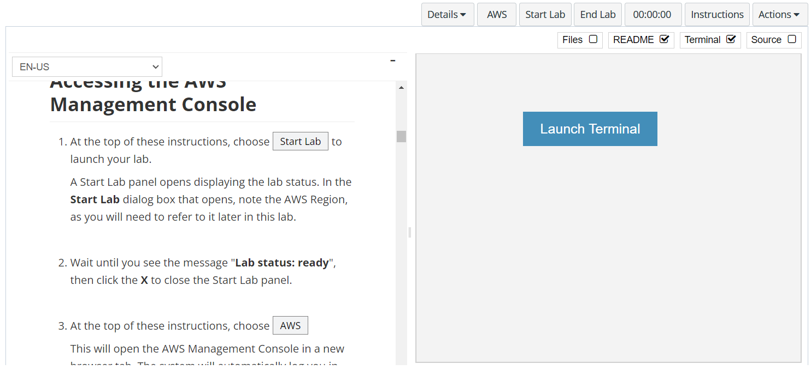
In aws labs click on start lab

Slide 4
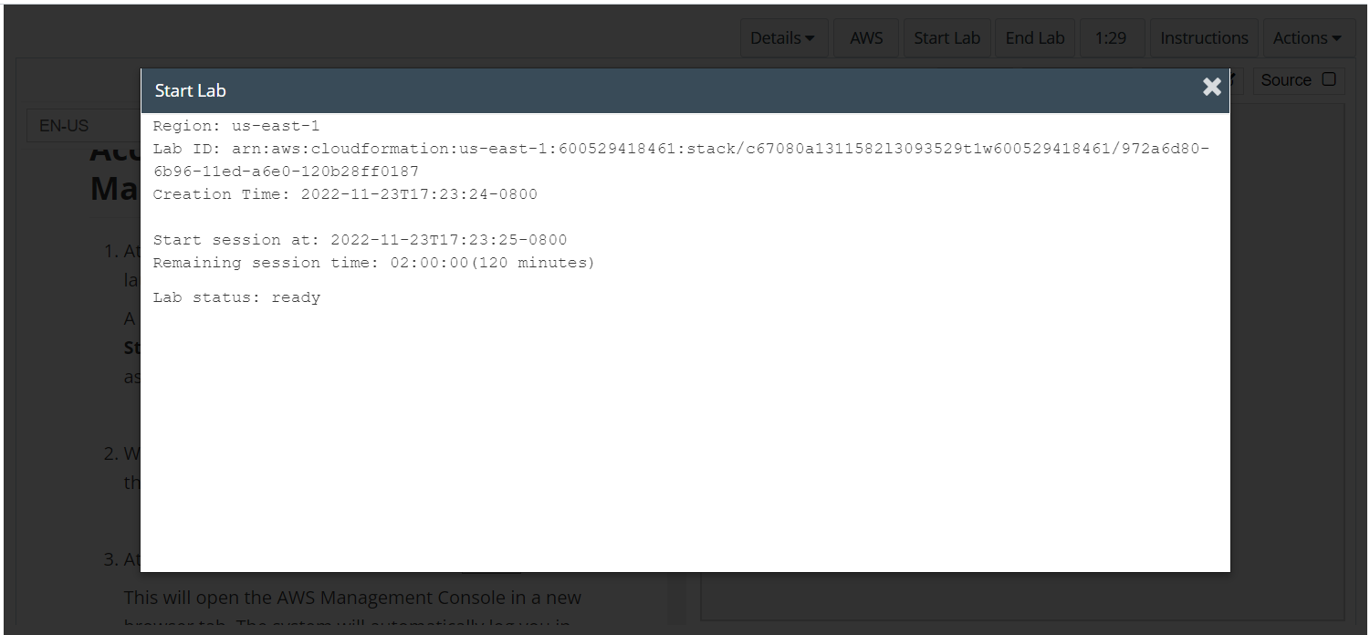
Wait to see lab ready status in the window then press x and click on aws to launch console

Slide 5
Task 1: Creating an RDS instance

Slide 6
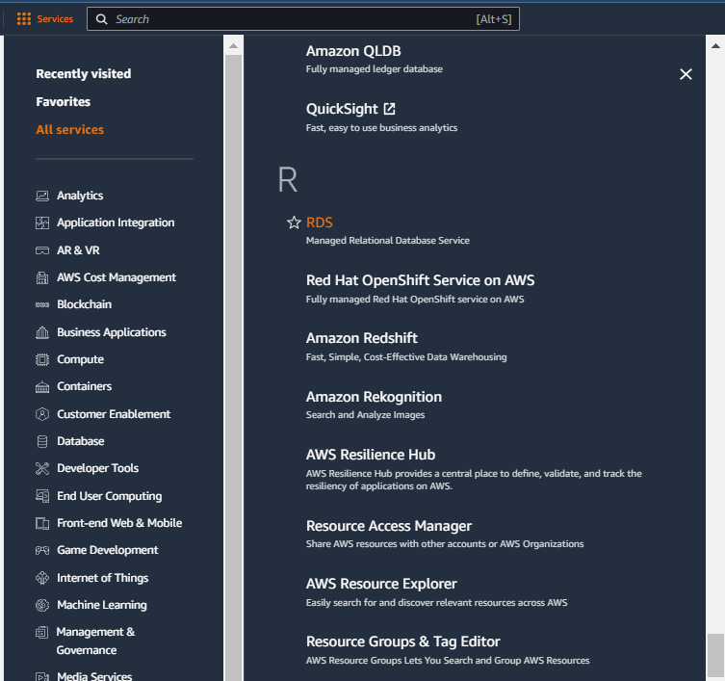
Select services and then click on rds button
Click on the Services button
Click on the RDS button

Slide 7
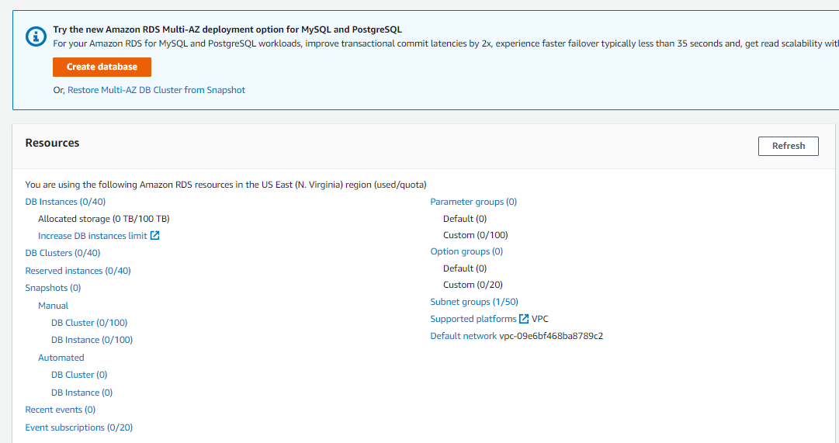
Click on create database button

Slide 8
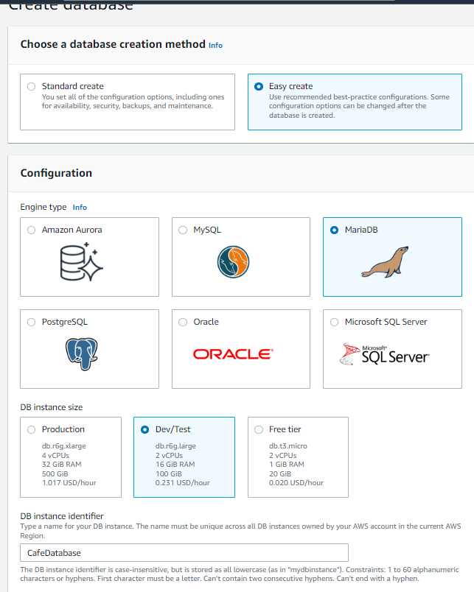
On the create database page, select easy create, mariadb and db instance type as dev/test

Slide 9
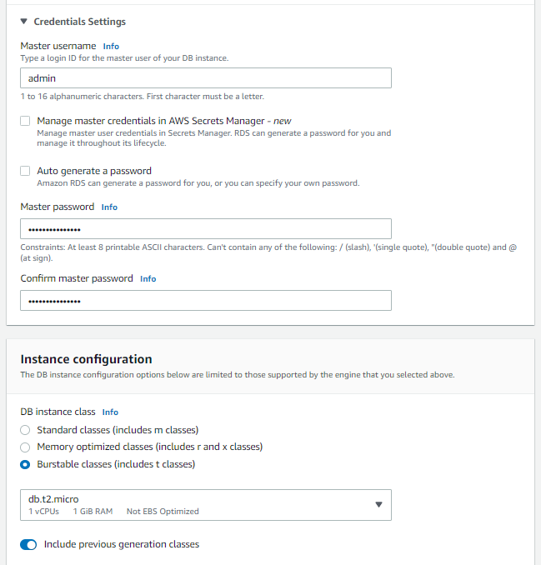
Set the username and password from aws labs, under instance configuration select burstable classes and also check include previous generation before selecting db.t.2micro

Slide 10
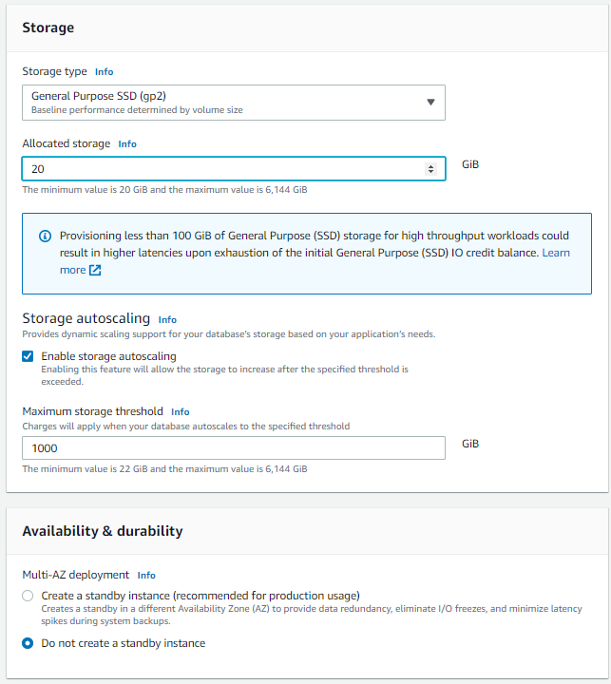
Change the storage settings and availability settings as shown

Slide 11
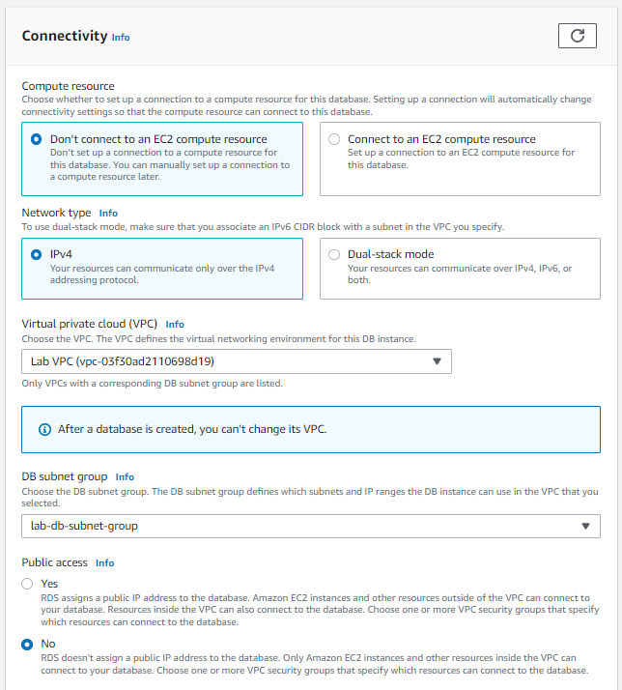
Configure the connectivity settings as mentioned in the labs and set it up in lab vpc and the subnet group as shown

Slide 12
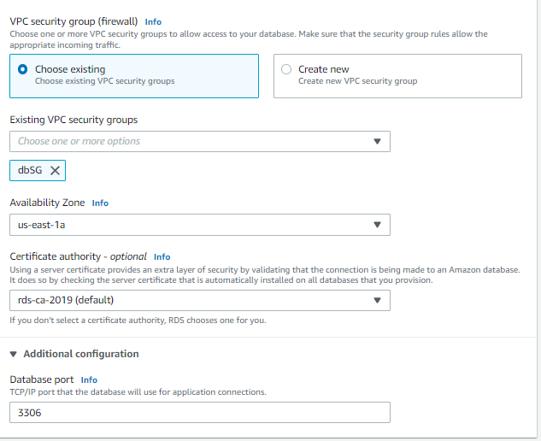
Choose the existing vpc security group and the availability zone as shown on the default port, disable advanced monitoring

Slide 13
Task 2: Analyzing the existing café application deployment

Slide 14
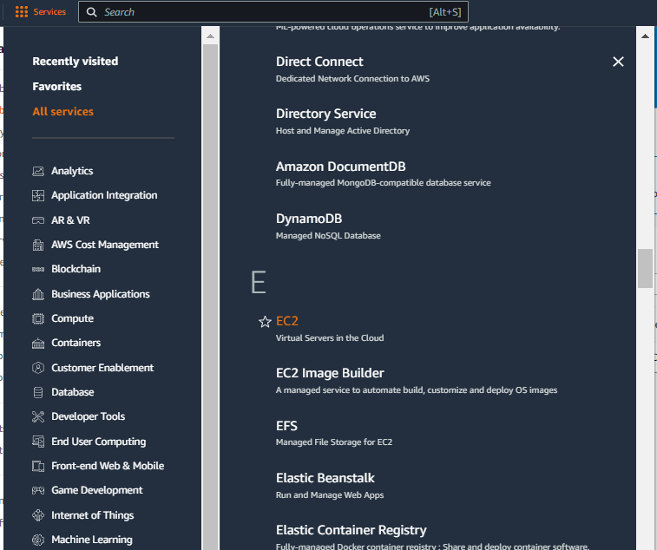
Select services and then click on EC2 button
Click on the Services button
Click on the EC2 button

Slide 15
THE CAFESERVER INSTANCE IS RUNNING, COPY THE IPV4 ADDRESS AND OPEN IT IN BROWSER

Slide 16
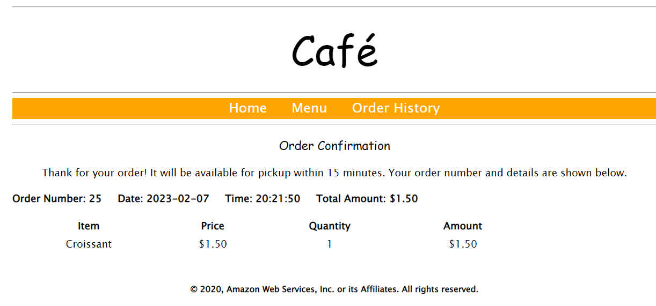
In the café page go to menu and try to order any item

Slide 17
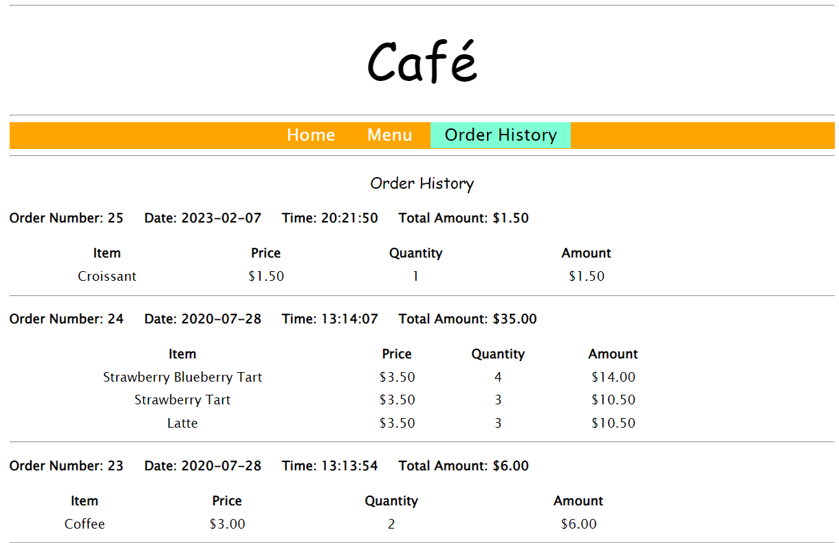
Go to order history to see the past orders that have been placed on the website

Slide 18
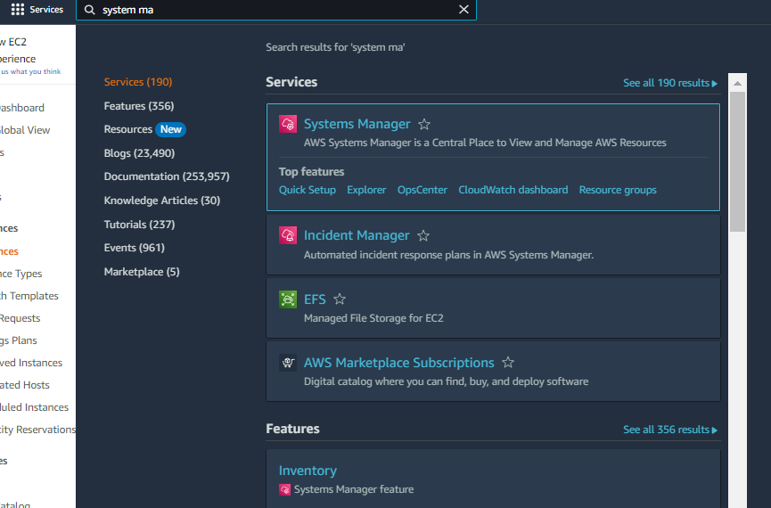
In services go to systems manager

Slide 19
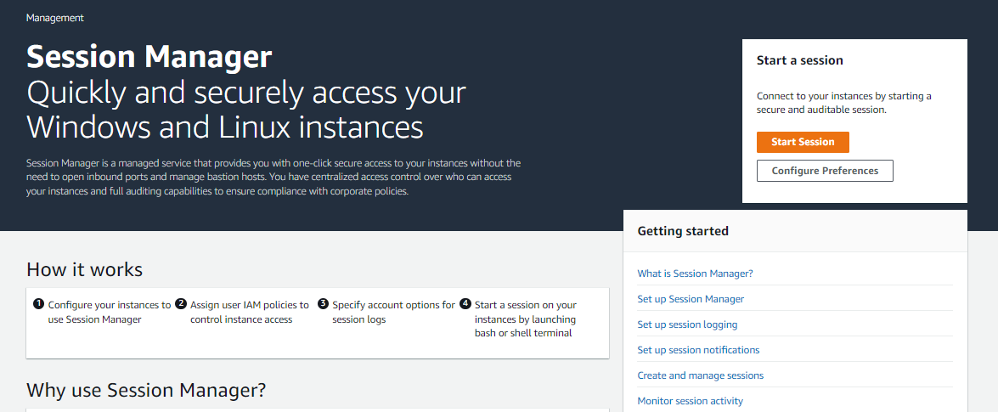
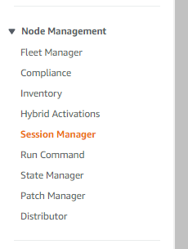
Go to sessions manager within system manager by scrolling to node management in the left pane and select session manager

Slide 20
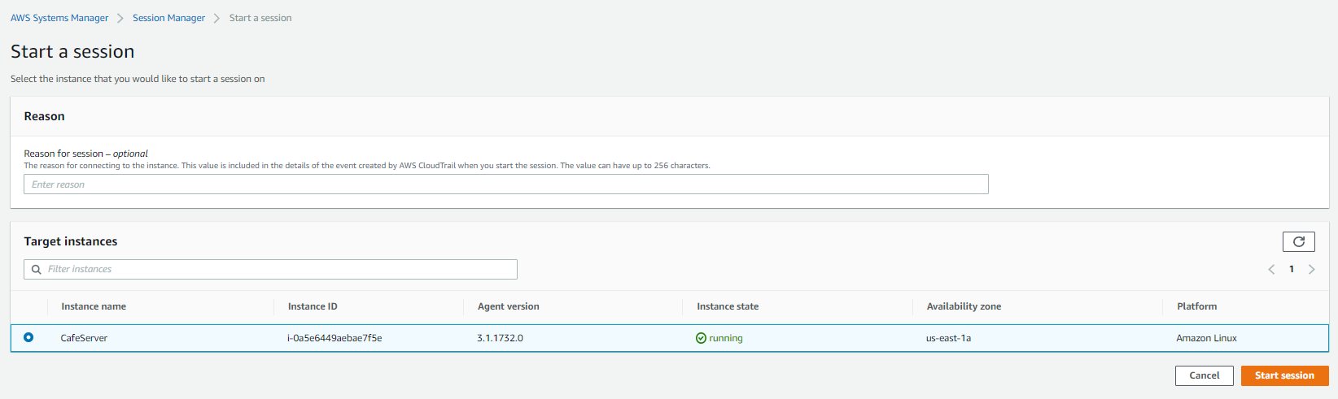
Click on start session and then select cafeserver then start session button

Slide 21
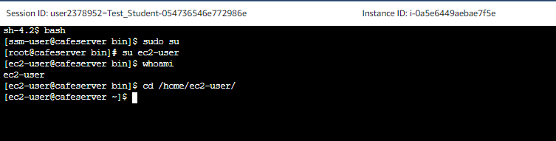
Run the following commands in the cli

Slide 22
Task 3: Working with the database on the EC2 instance

Slide 23
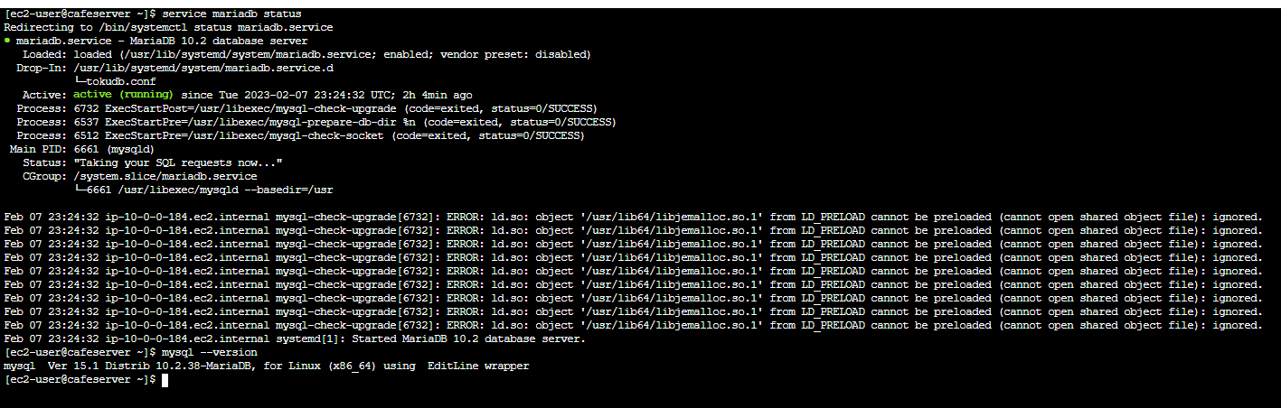
Run the commands for checking the status of database to see that they are not currently running, check also the version of the mysql version

Slide 24
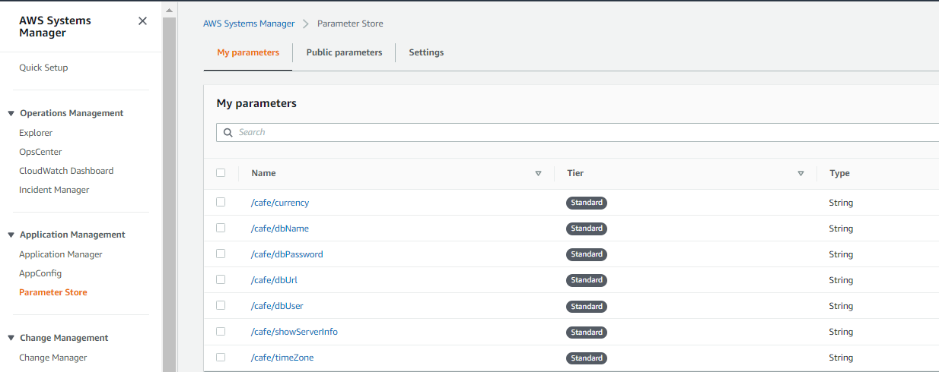
Back in the console switch to application management > parameters store

Slide 25
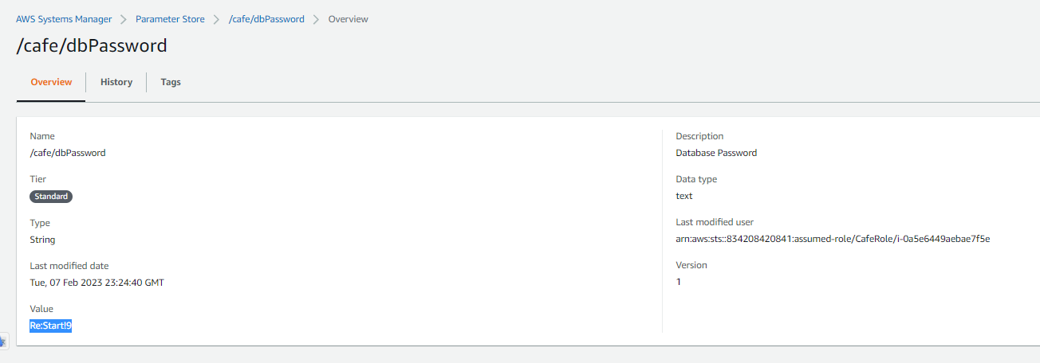
Copy the value of café/db/password

Slide 26
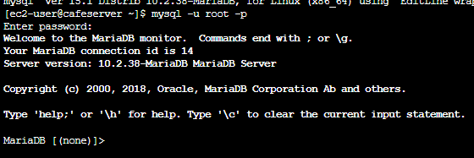
Copy and paste the password when prompted in the cli

Slide 27
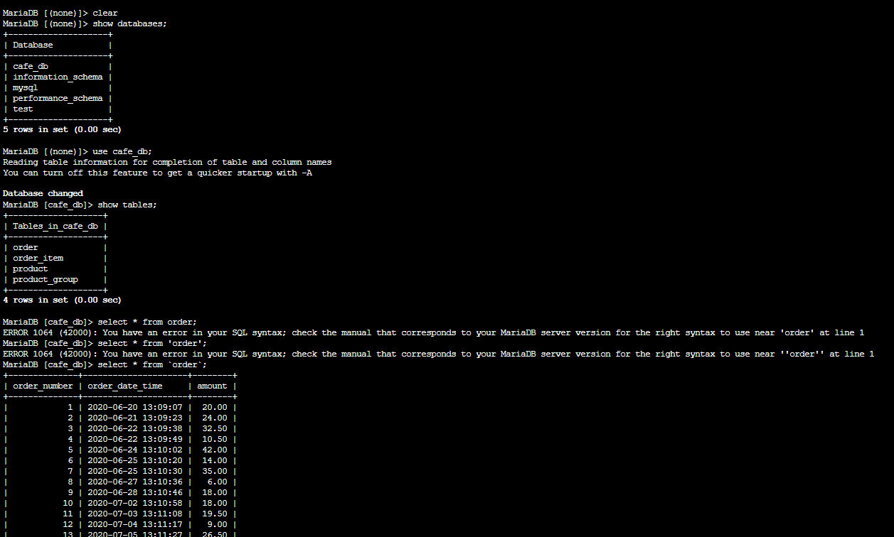
Run the commands in aws labs to see the database in mariadb and its contents, type exit to exit the database

Slide 28
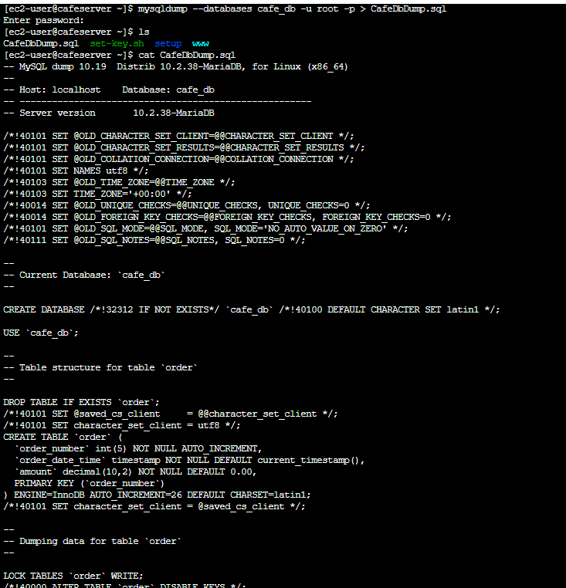
Run the mysqldump code to capture existing data , the password would be the one in parameter store, verify that data has been captured

Slide 29
Task 4: Working with the RDS database

Slide 30
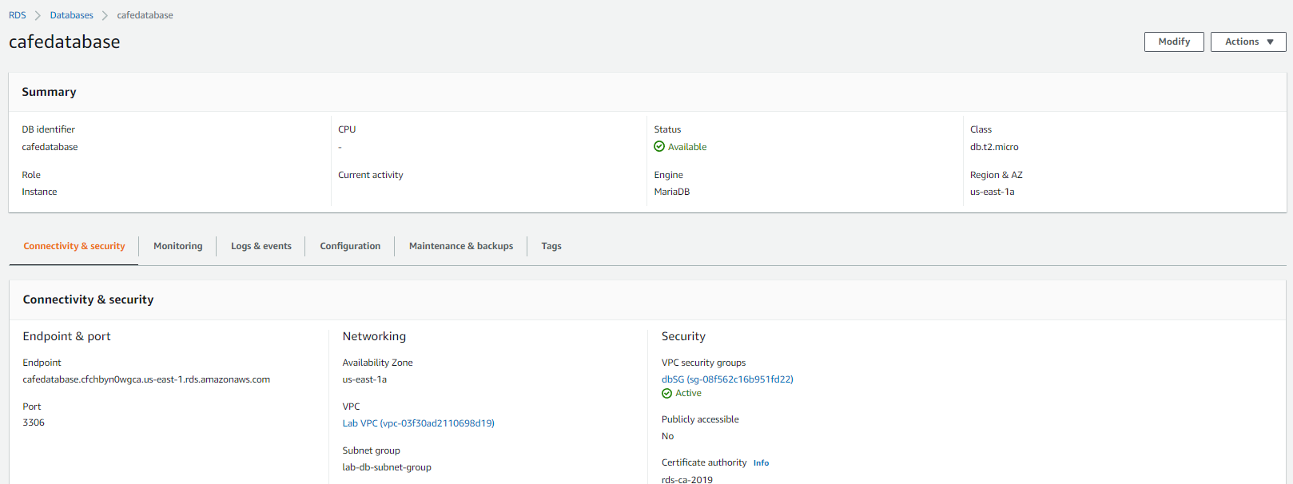
Go back to RDS page to verify your database has been created

Slide 31
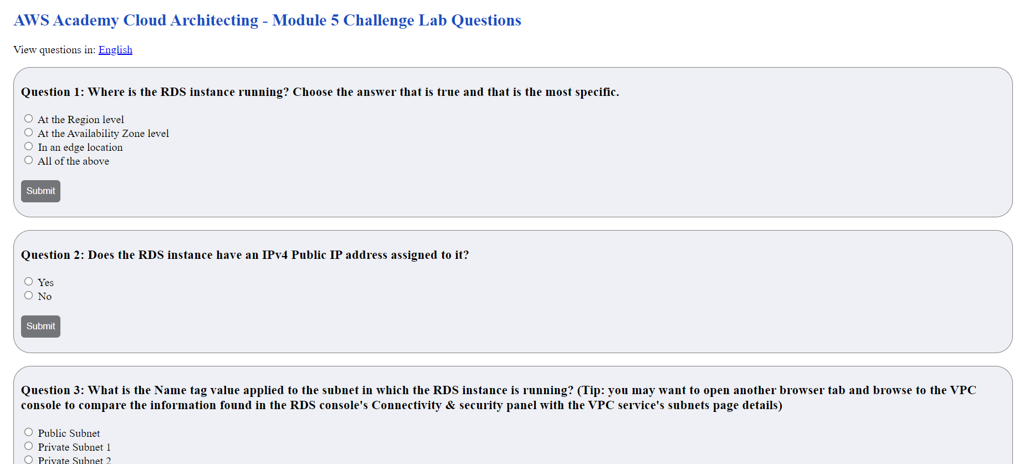
Answer the question in aws labs

Slide 32
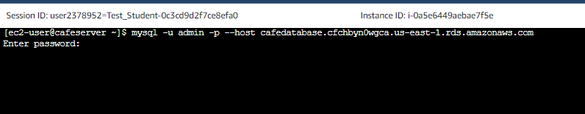
Try to connect to the rds database in the cli, using the endpoint that is present in RDS and enter the PWD when prompted you will notice that it does not allow you to login

Slide 33
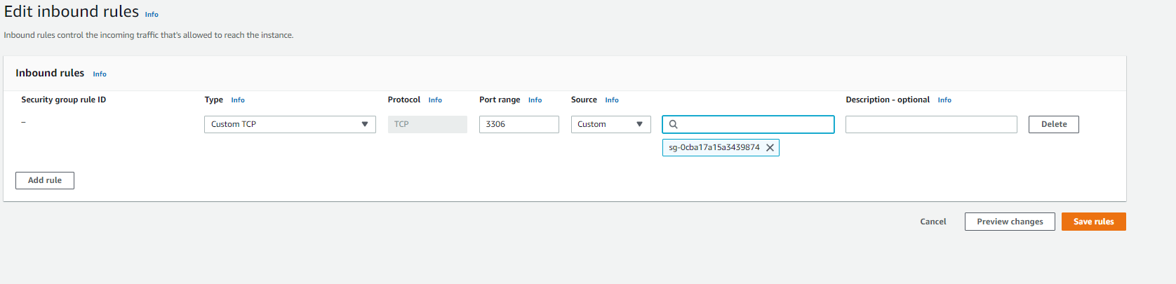
In the security groups edit the dbsg to allow connection from port 3306 for the ec2 instance ip

Slide 34
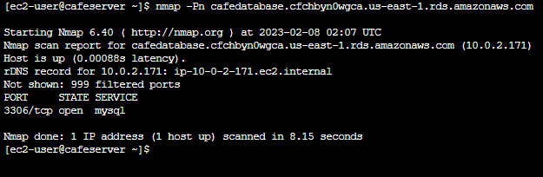
Run the following command to check if the connection port is open

Slide 35
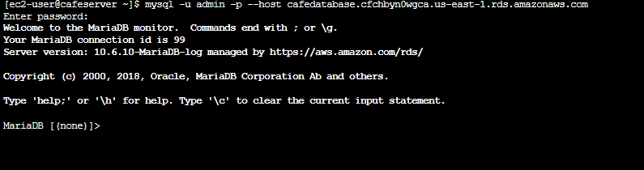
Now run the command and enter password

Slide 36
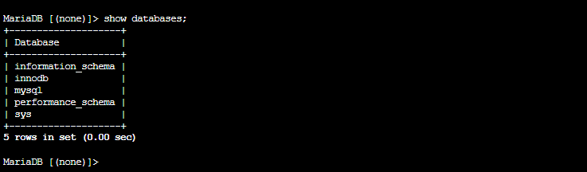
Run show databases to see the available databases

Slide 37
Run show databases to see the available databases, cafedb is not available currently exit the database

Slide 38
Task 5: Importing the data into the RDS database instance

Slide 39
Copy the cafedb database to rds database

Slide 40
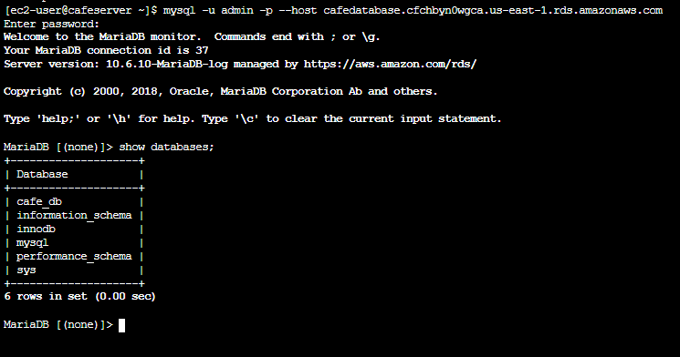
Validate if the data has been copied

Slide 41
Task 6: Connecting the café application to the new database

Slide 42
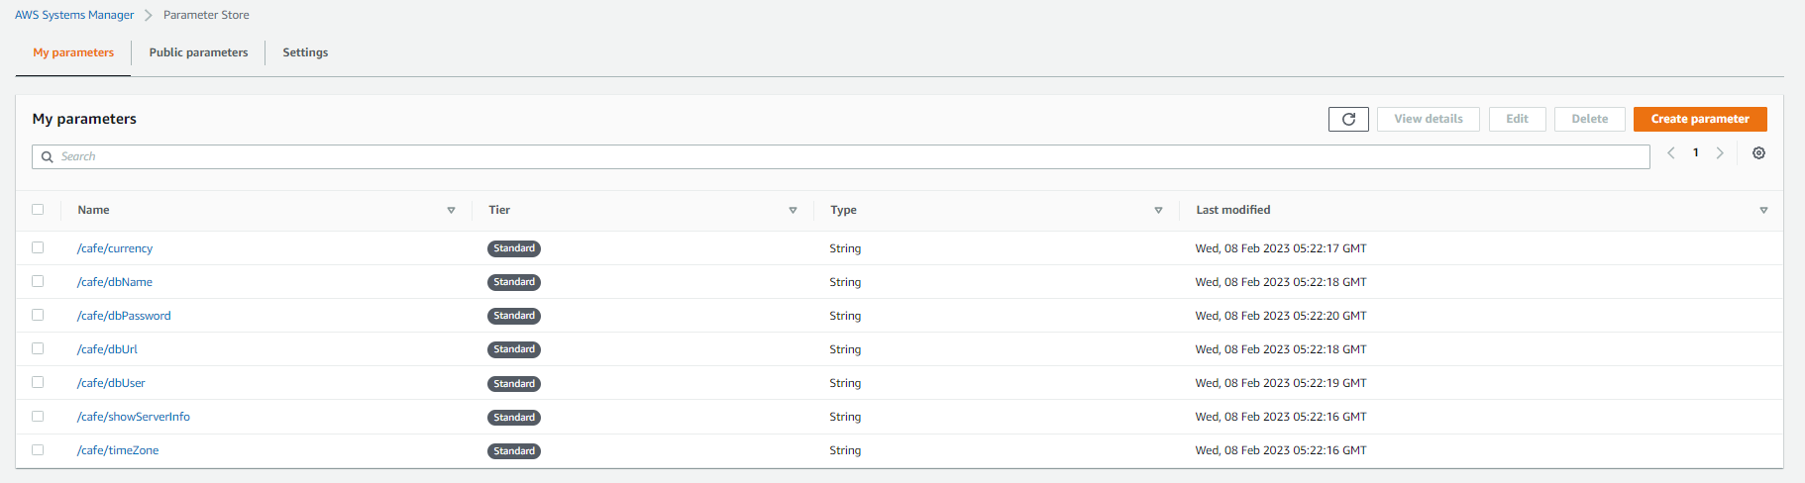
Goback to systems manager > parameter store and then open dburl

Slide 43
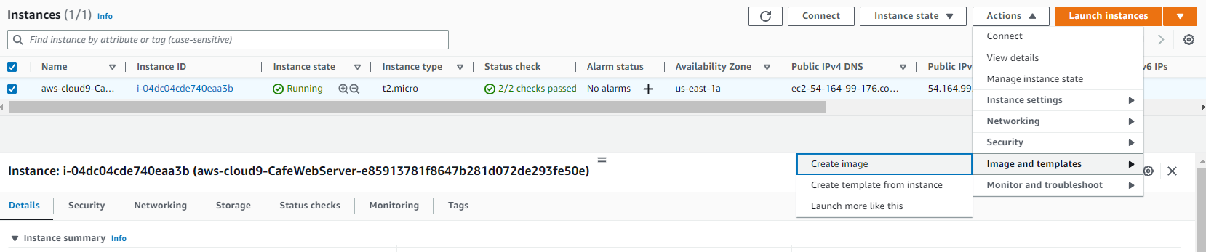
Create an image in instances by selecting the instance > actions > images and templates > create image

Slide 44
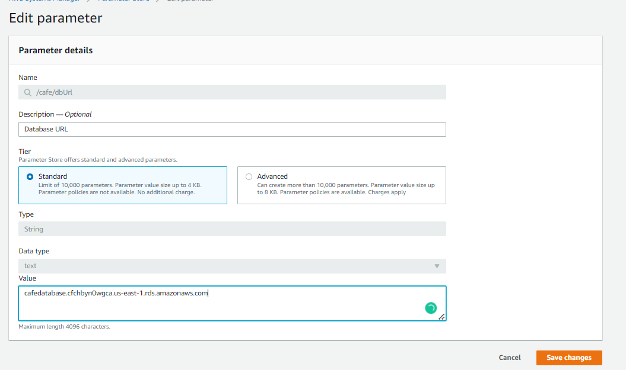
Update the value to the rds instance endpoint

Slide 45
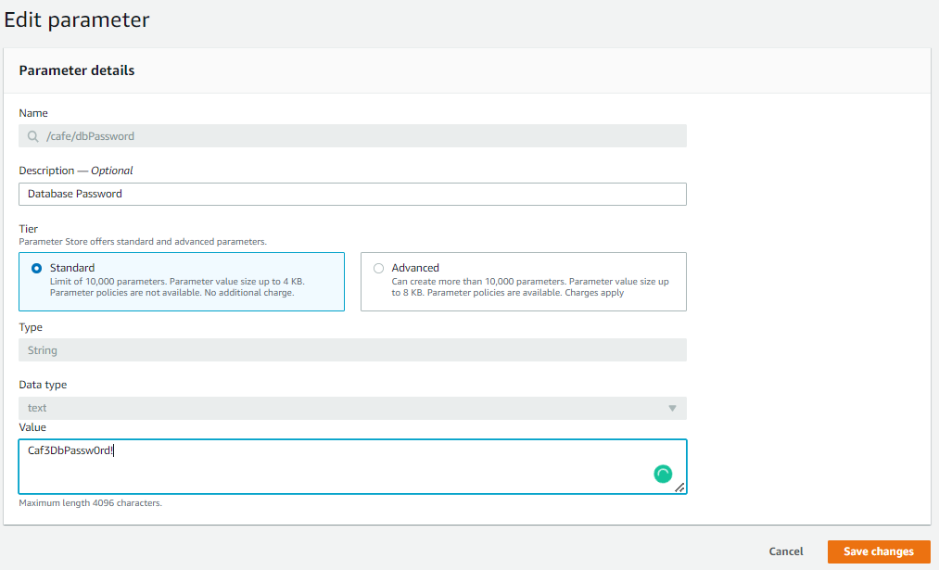
Change the cafedbpassword parameter store

Slide 46
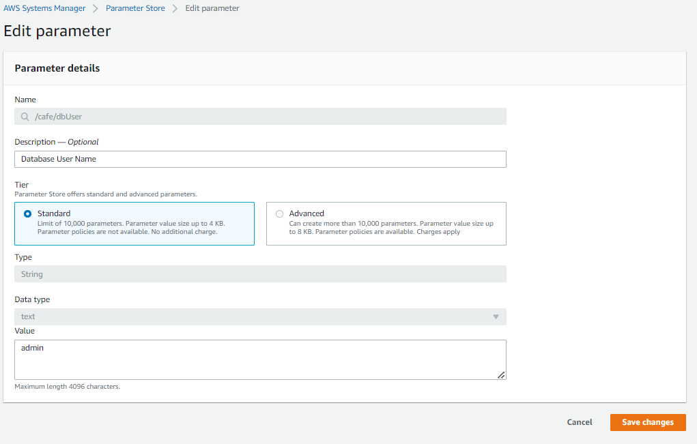
Change cafedbuser username in parameter store

Slide 47
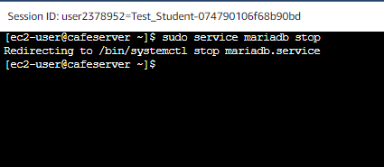
Stop the DB running on ec2 instance

Slide 48
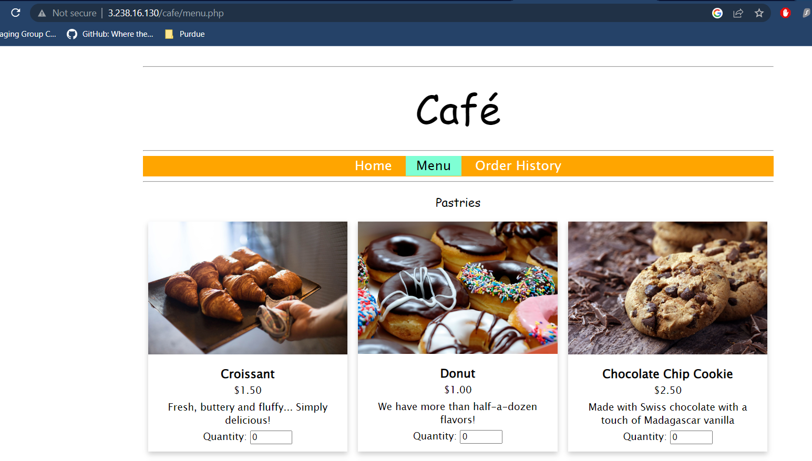
Load the url in aws labs to enure the new DB is working

Slide 49
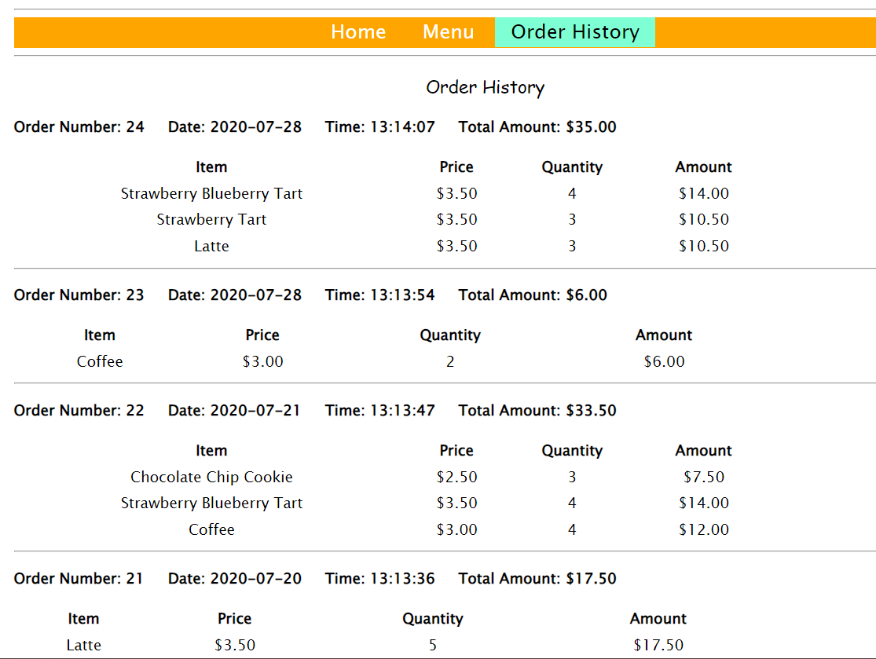
Order history has the required data

Slide 50
THANK YOU
Amrit Singh

